Slide 1
PROJECT TITLE : MEDICAL INVENTORY MANAGEMENT SYSTEM
COLLEGE NAME:
NANDHA ARTS AND SCIENCE COLLEGE [AUTONOMOUS]
COLLEGE ID:
BRU4J
TEAM ID:
TEAM MEMBERS:
TEAM LEADER NAME: KEERTHANA A
EMAIL: keerthanaanandakumar1@gmail.com
TEAM MEMBER1: KANIMOZHI M
EMAIL: kkani0656@gmail.com
TEAM MEMBER2: INDHUMATHI P
EMAIL: indhup741@gmail.com
TEAM MEMBER3: DHANUSHREE V
EMAIL: dhanushree9@gmail.com

Slide 2
INTODUCTION
PROJECT OVERVIEW:
This project is a comprehensive Salesforce application to streamline and manage various operational aspects of medical inventory. The system aims to efficiently maintain supplier details, manage purchase orders, track product details and transactions, and monitor the expiry dates of products. Maintain detailed records of suppliers, including contact information. Catalog product information, including descriptions, stock levels. Monitor and track product expiry dates to avoid using expired items. Comprehensive reports to track supplier performance, and purchase orders.

Slide 3
Objectives
Develop a centralized platform to manage medical inventory.
Enable real-time tracking of stock levels and expiry dates.
Generate automated alerts for low-stock and near-expiry products.
Maintain a transaction history for audits and regulatory compliance.
Provide analytics dashboards for decision-making

Slide 4
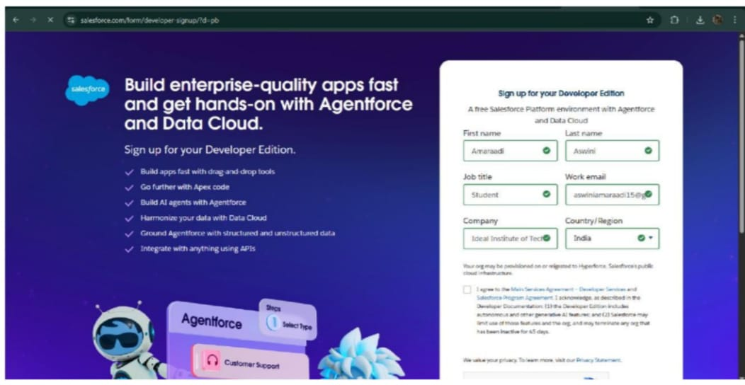
DEVELOPER PHASE
Creating Developer Account:
By using this URL –
https://www.salesforce.com/form/developer-signup/?d=pb

Slide 5
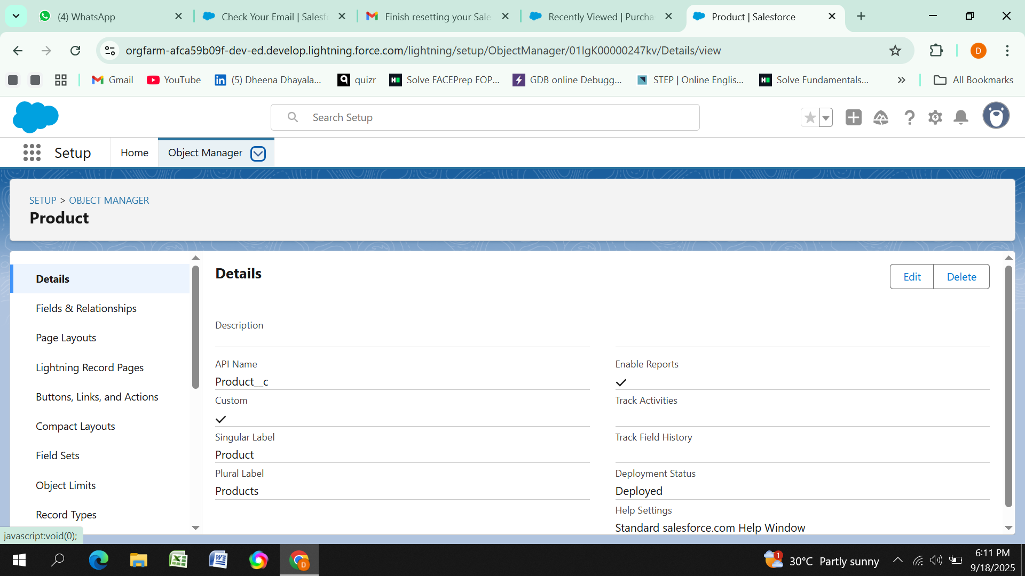
Create Purchase Order, Order Item, Inventory Transaction and Supplier objects.

Slide 6
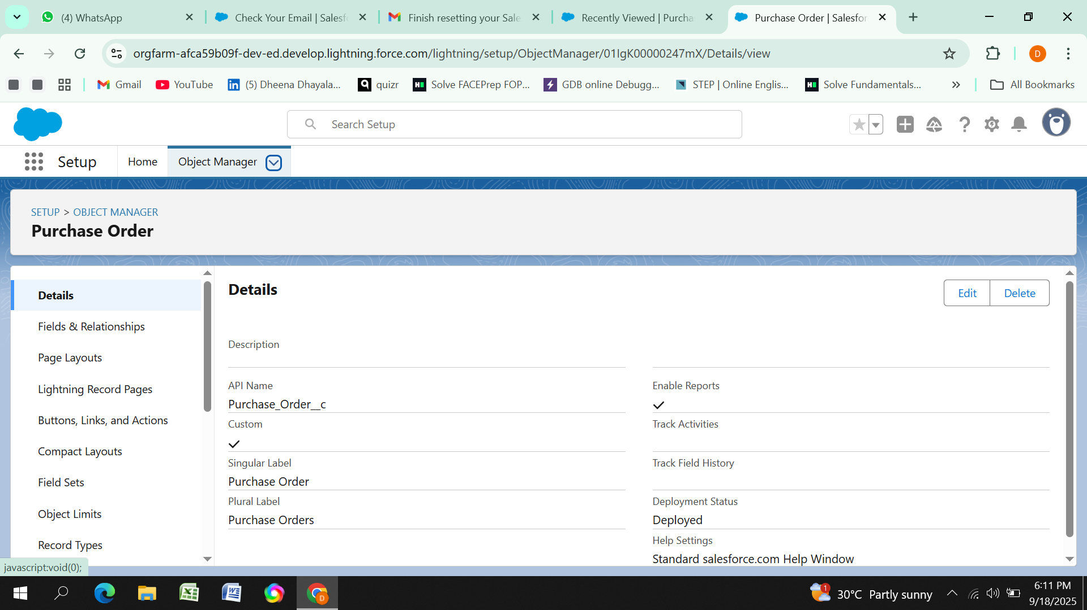


Slide 7
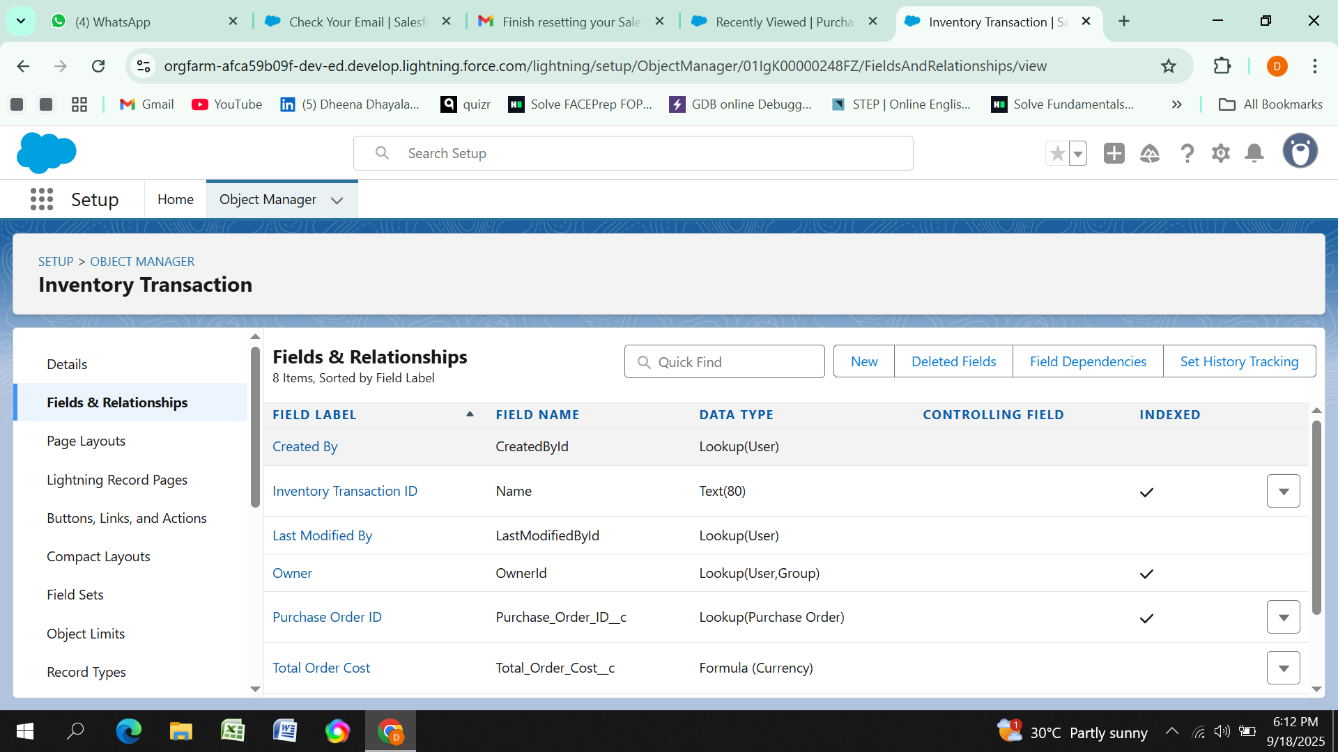
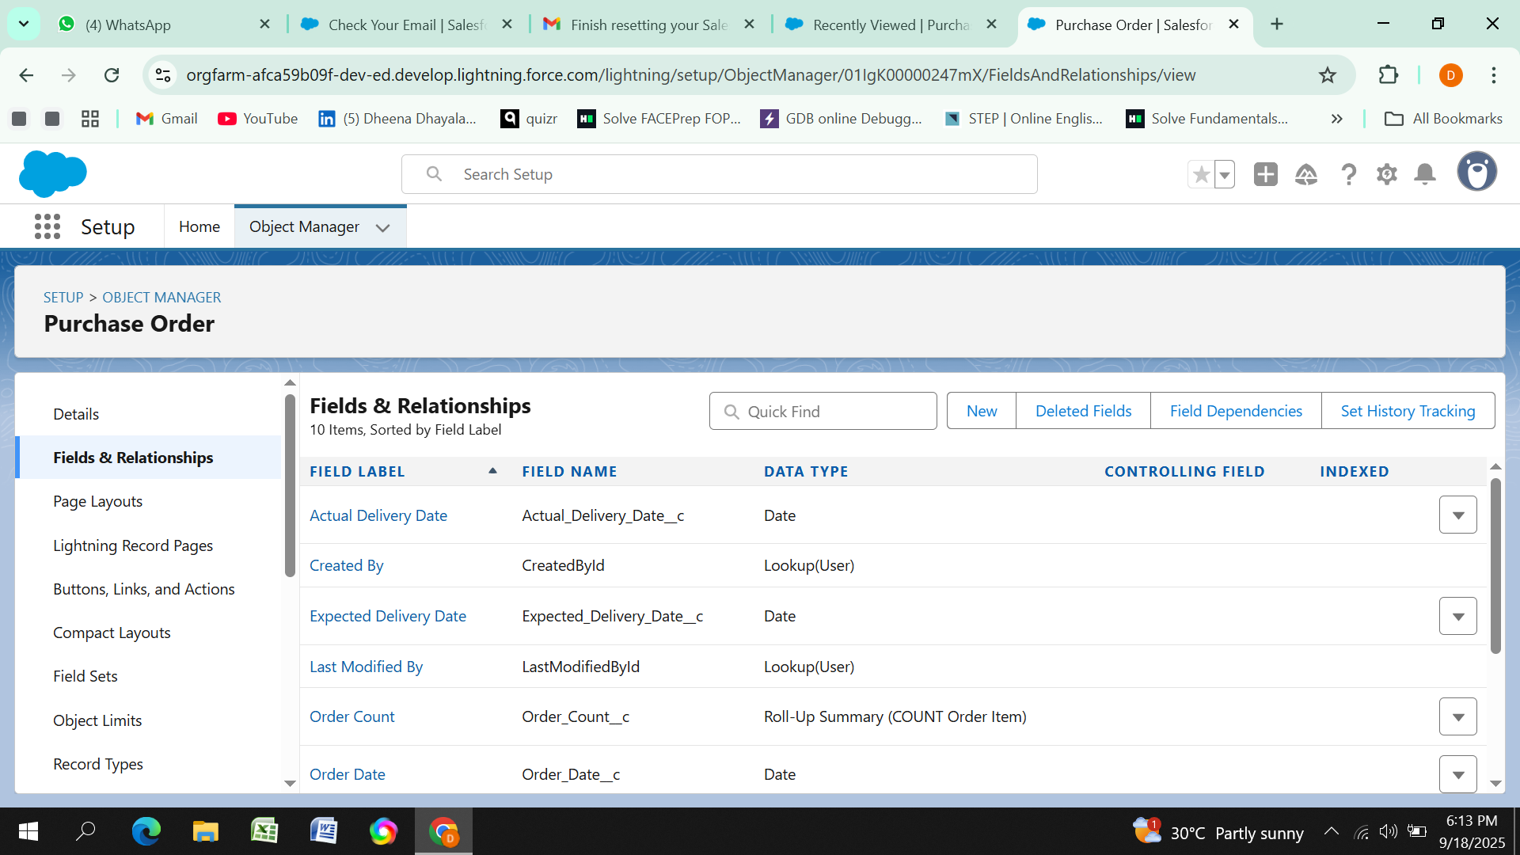
Configured fields and relationships

Slide 8
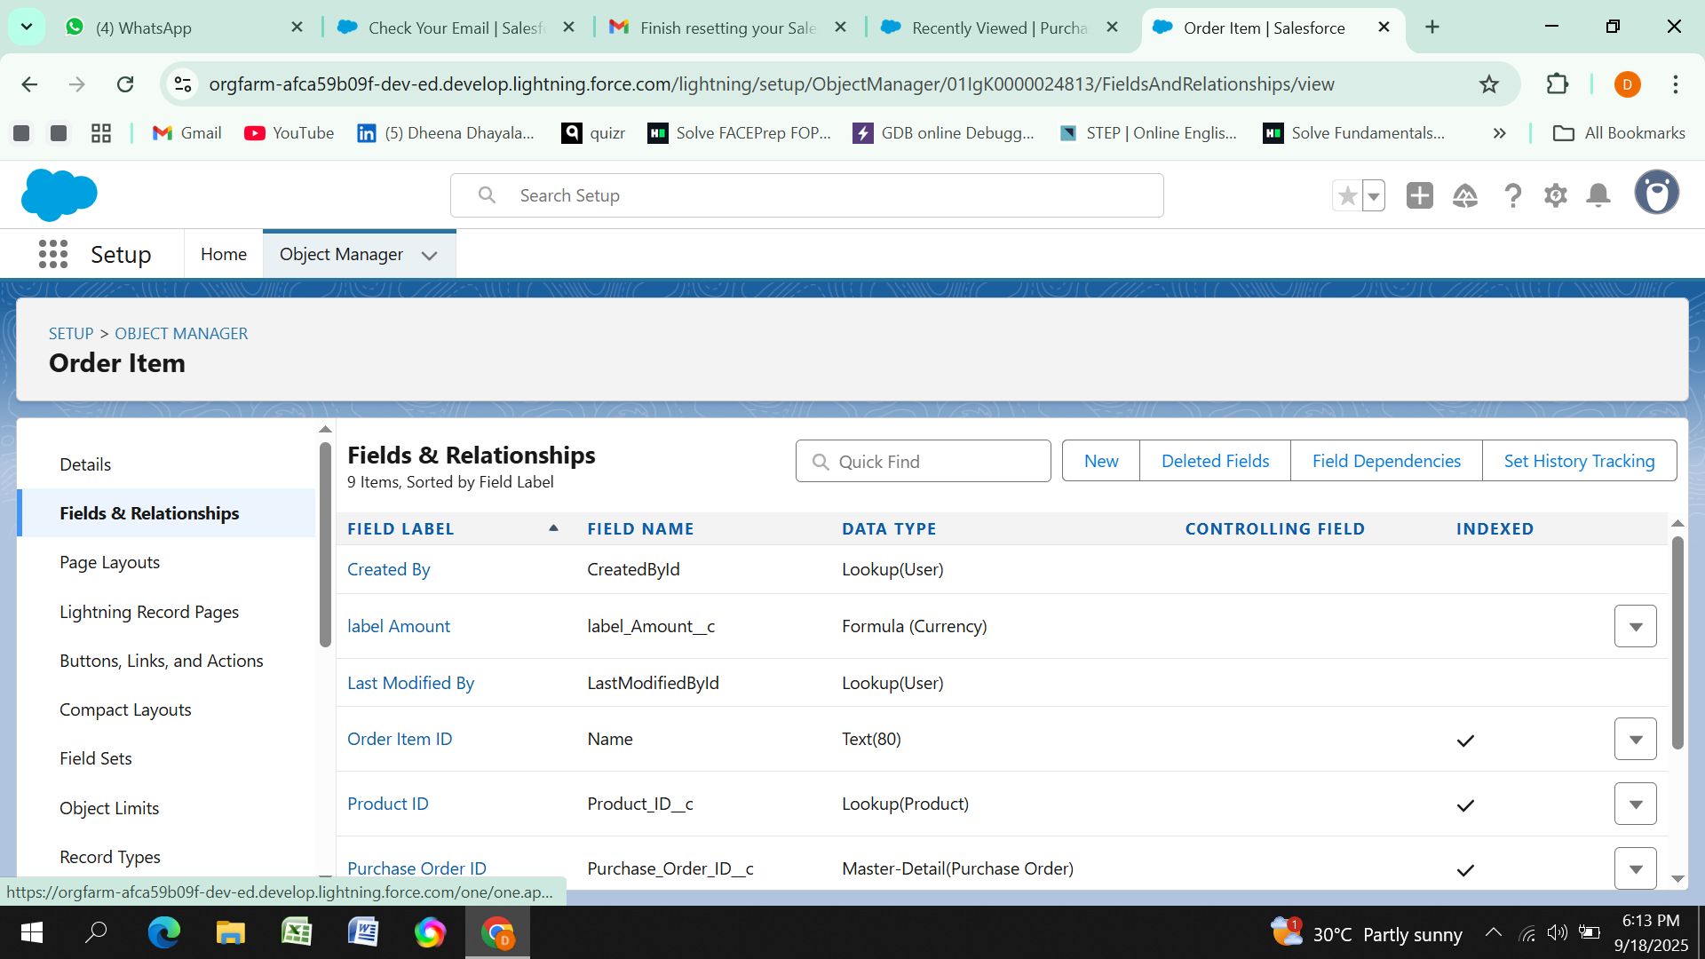
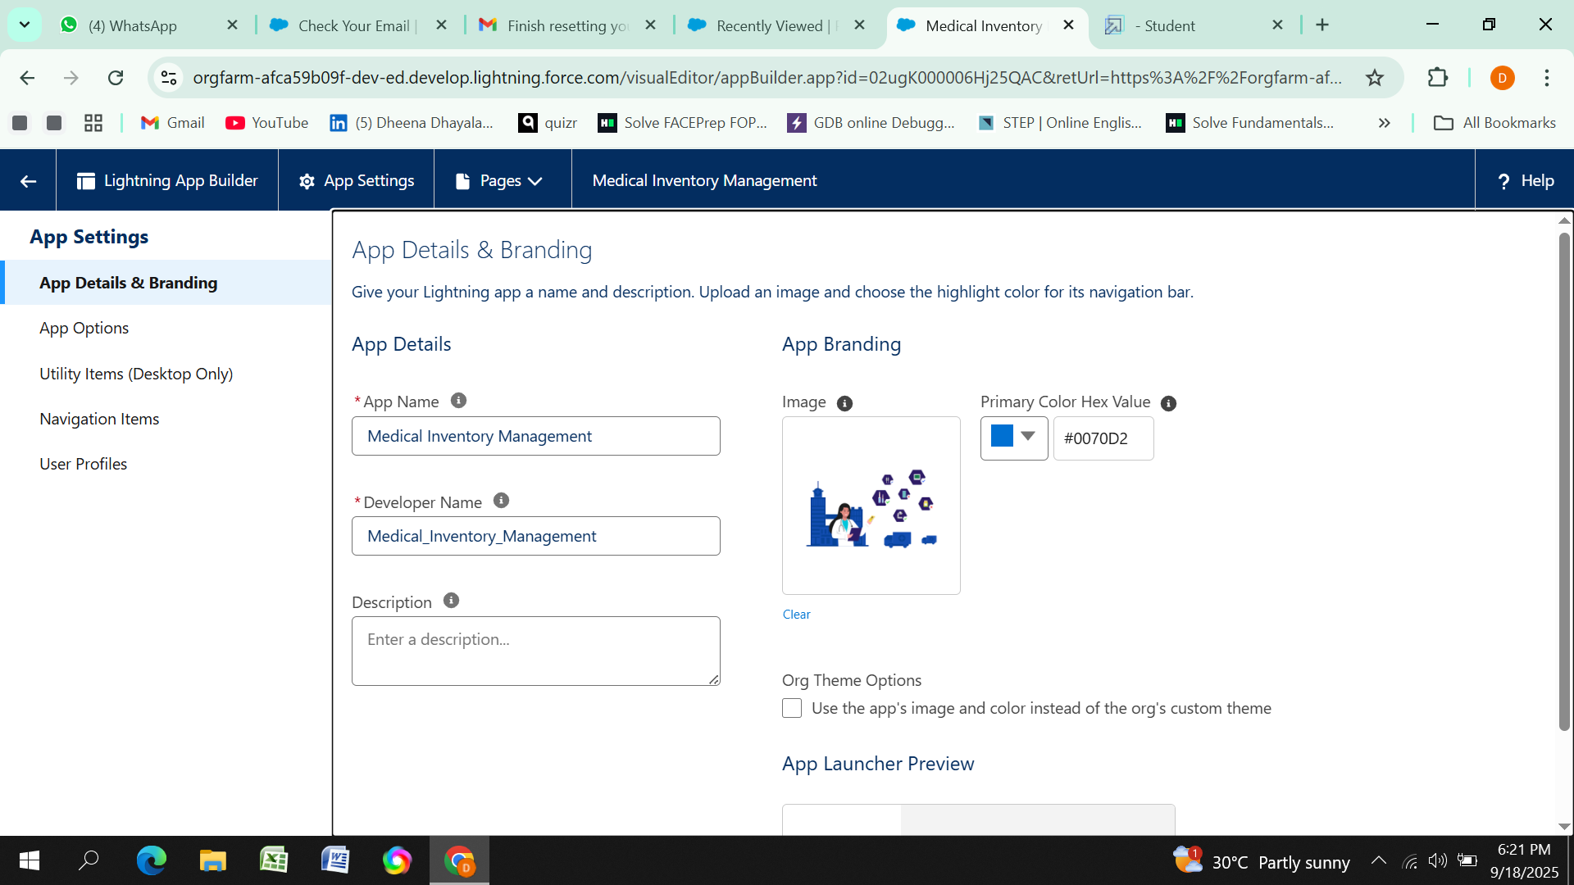
Developed Lightning App with relevant tabs

Slide 9
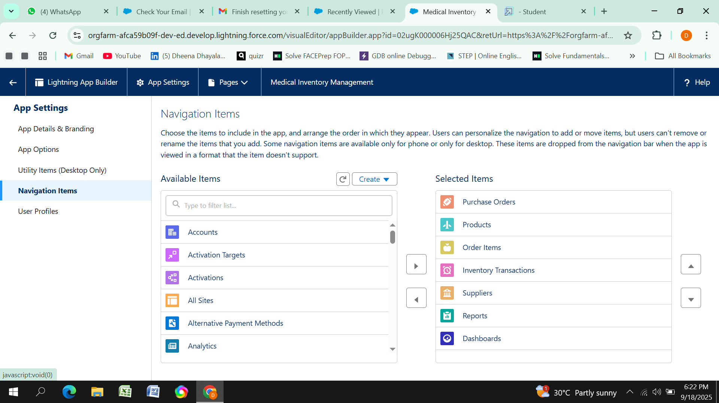
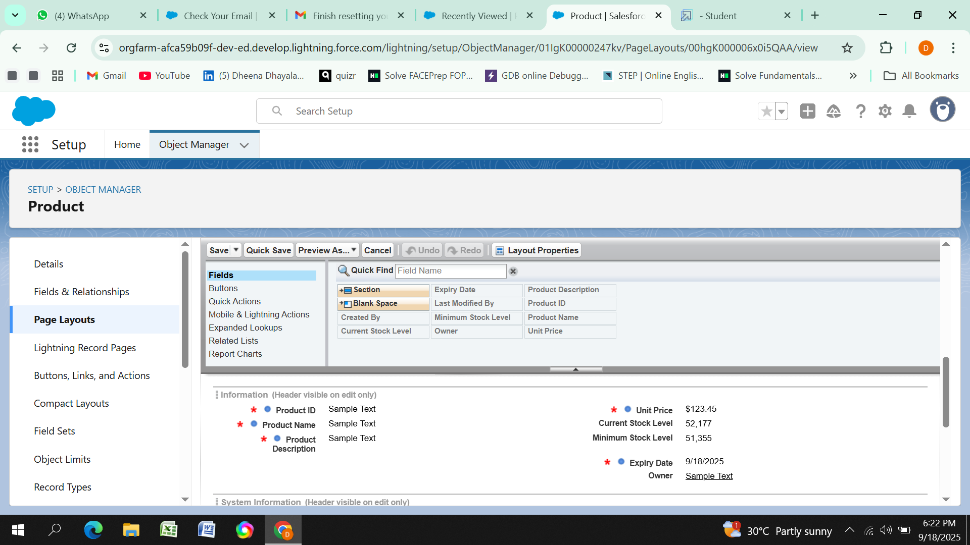
Editing of Page Layouts

Slide 10
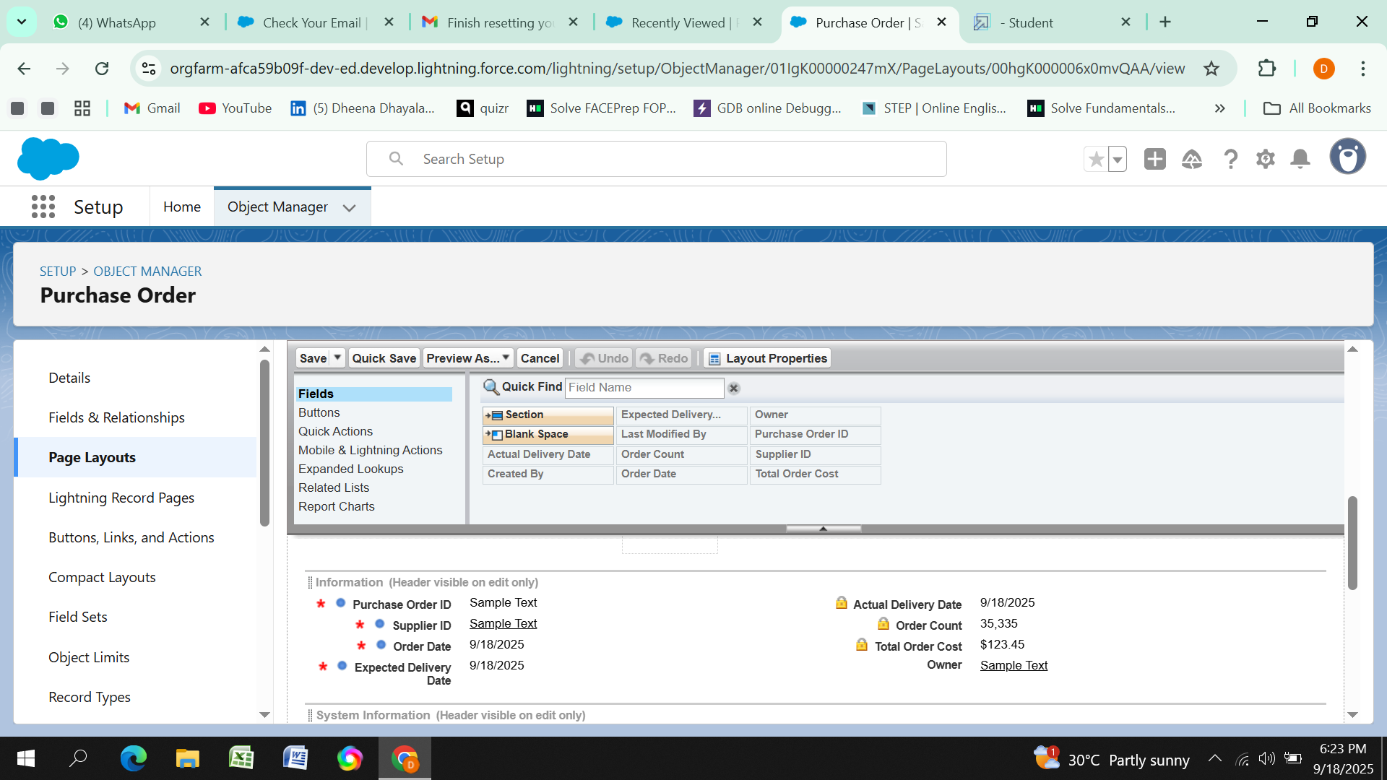
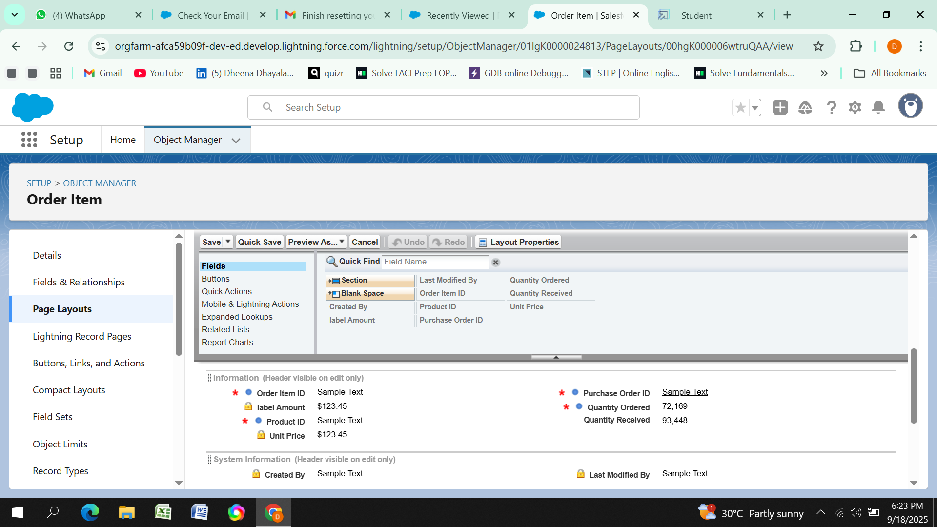

Slide 11
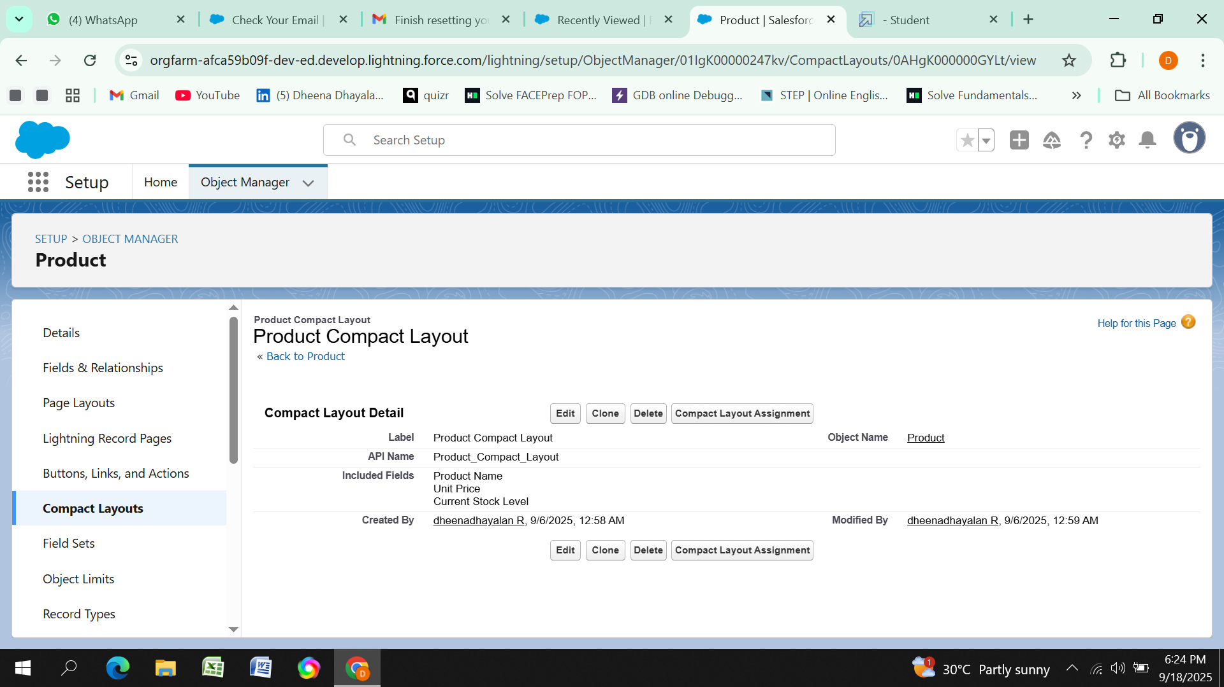
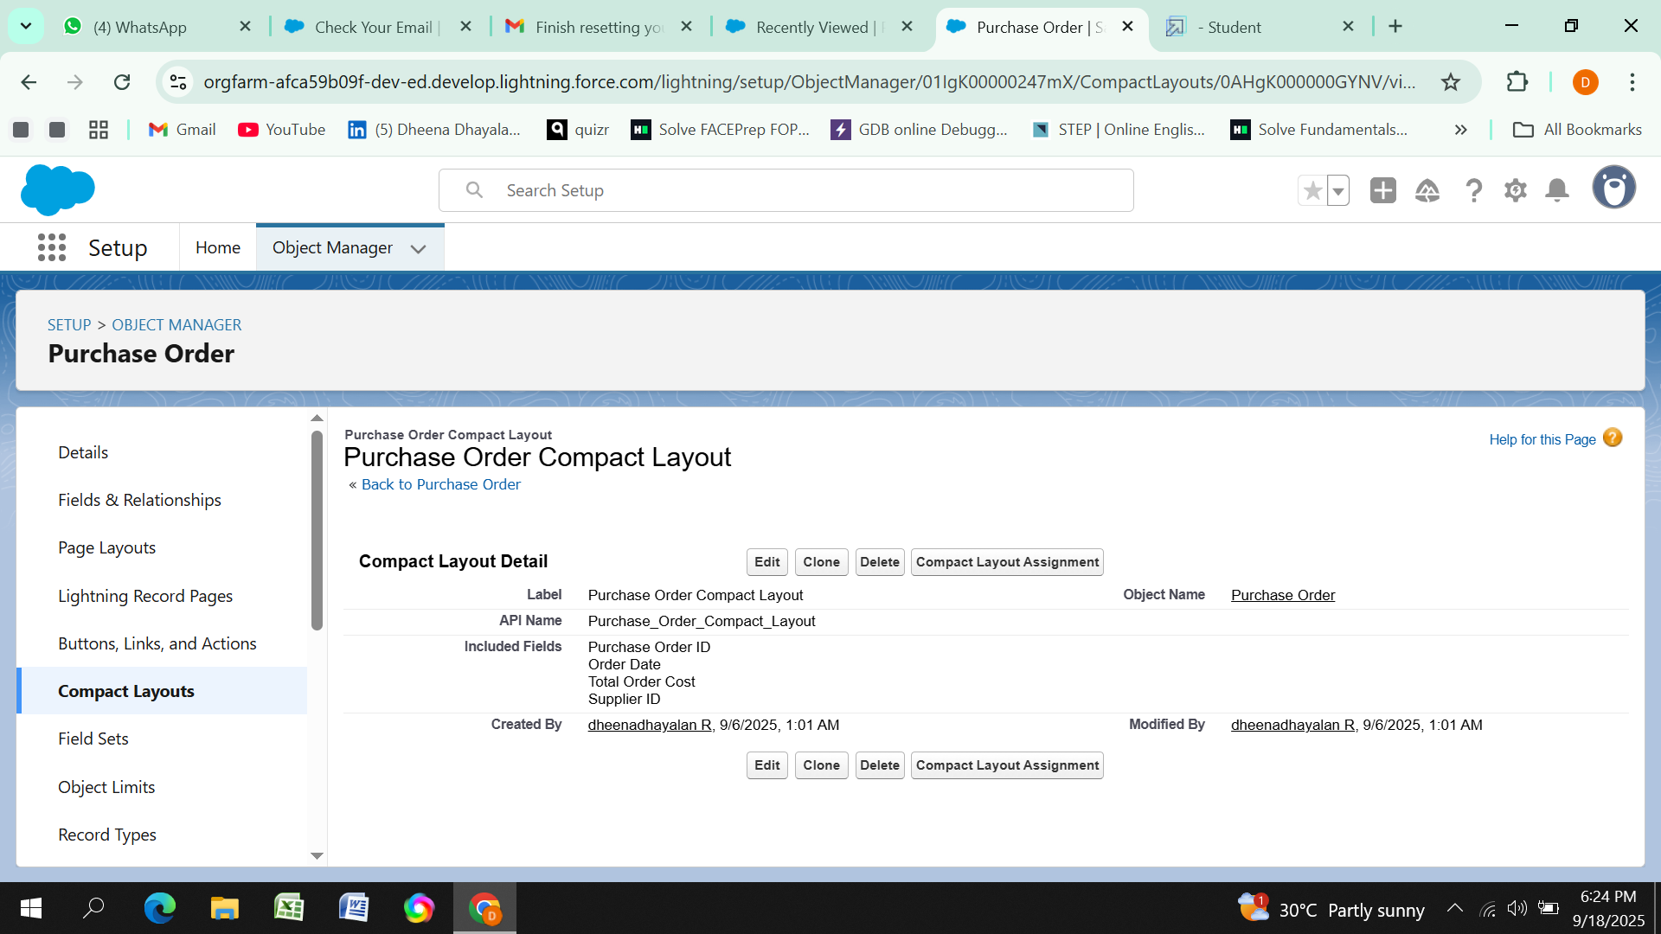
Compact Layouts
Compact layouts display a record’s key fields at a glance, providing important information quickly without needing to open the record.

Slide 12
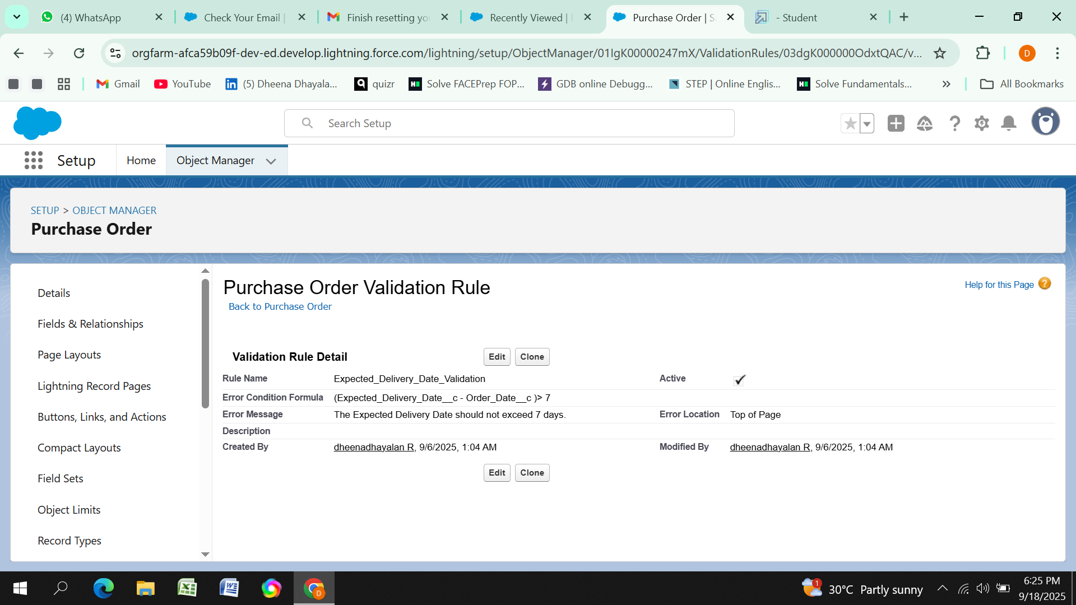
Validation Rules

Slide 13
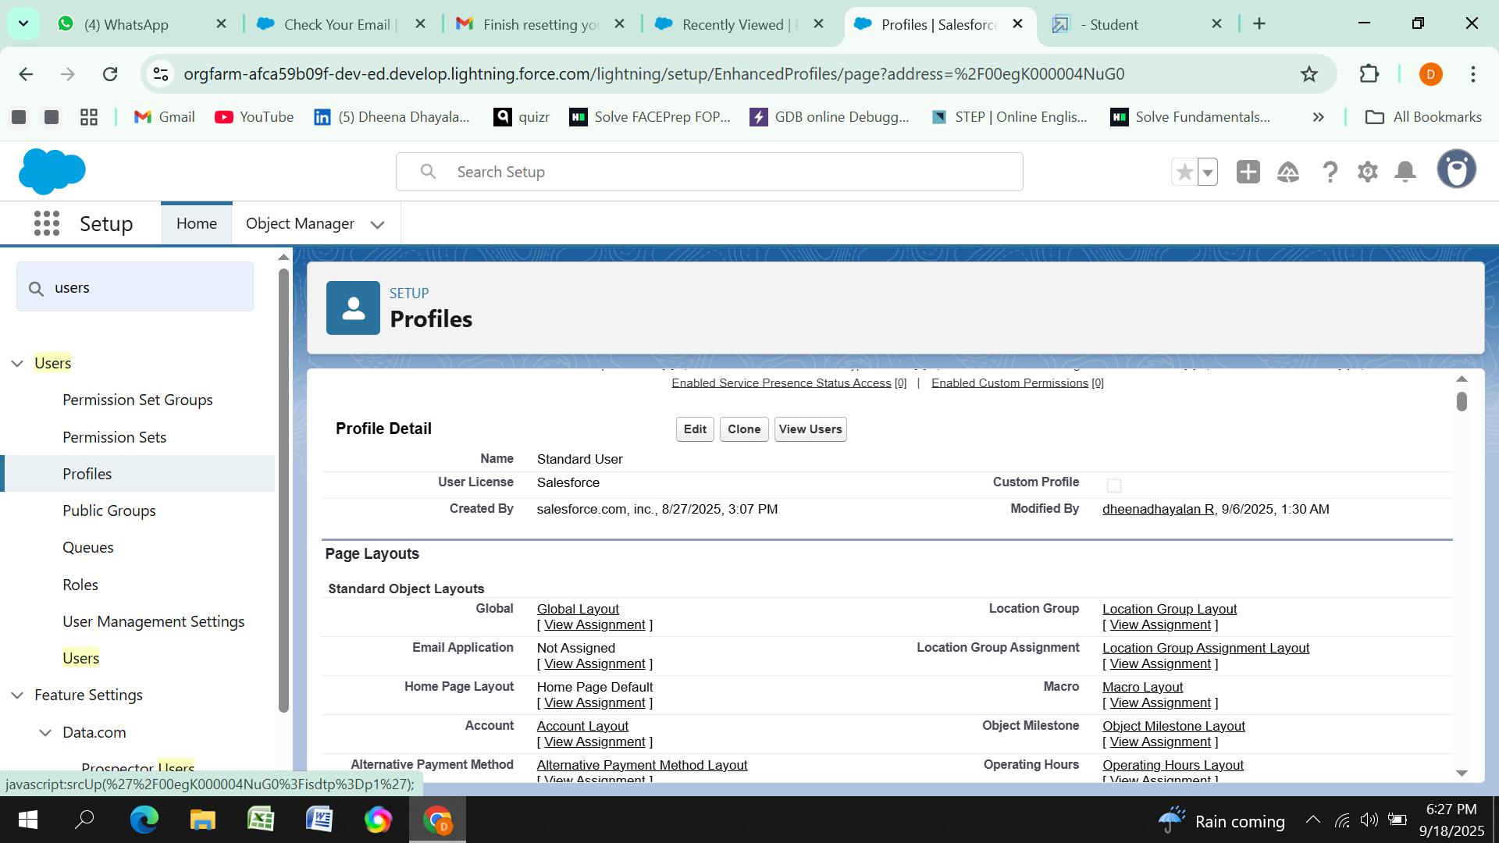
Profiles
Profiles in Salesforce are fundamental to the platform's security model, defining what users can do within the organization. Profiles control a user’s permissions to objects, fields, tabs, apps, and other settings. Each user in Salesforce must be assigned a profile, and the profile assigned to a user determines what they can see and do in the system.
Roles And Users
Roles in Salesforce are used to control record-level access and define the hierarchy of an organization, determining the level of visibility and sharing of records among users. Roles work in conjunction with profiles to provide a robust security model. While profiles control what actions users can perform (object and field permissions), roles control which records users can see based on their position in the hierarchy.

Slide 14
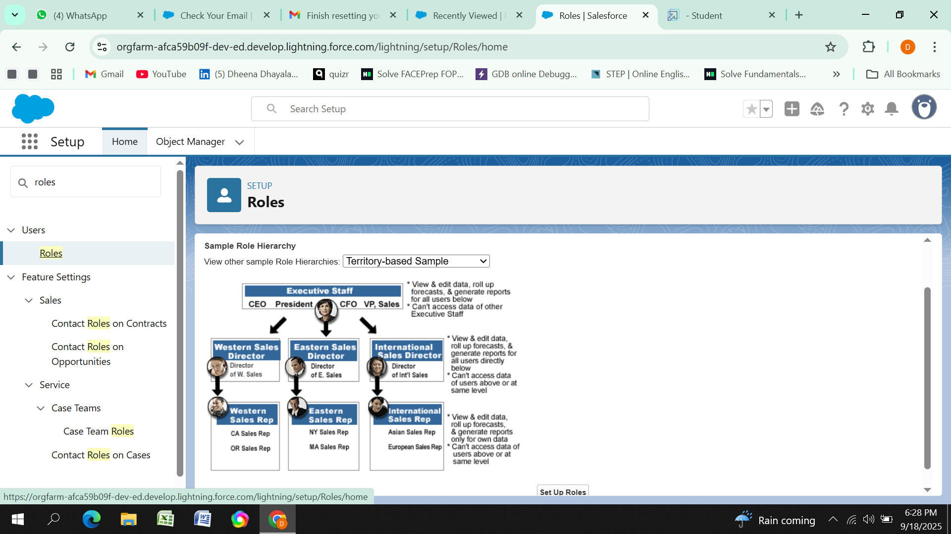
Permission Sets
Permission Sets in Salesforce are a powerful tool to extend user permissions beyond what is defined in their profiles. They allow administrators to grant additional access to various tools and functions without altering the user's profile. Permission sets are particularly useful for providing specialized permissions to specific users without the need to create multiple profiles

Slide 15
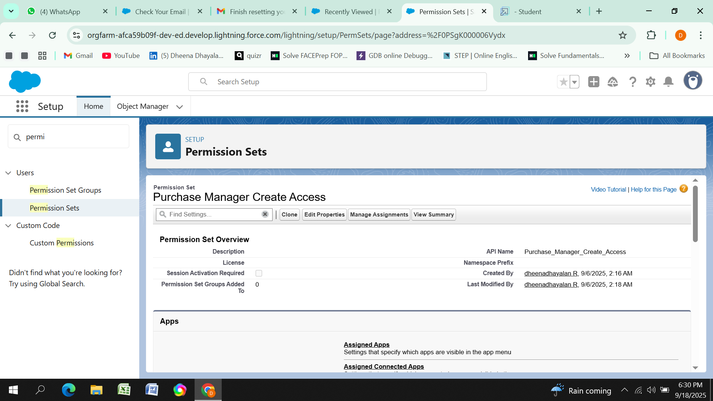
Flows
Flows in Salesforce, part of the Lightning Flow product, are powerful automation tools that help you collect data and perform actions in your Salesforce environment

Slide 16
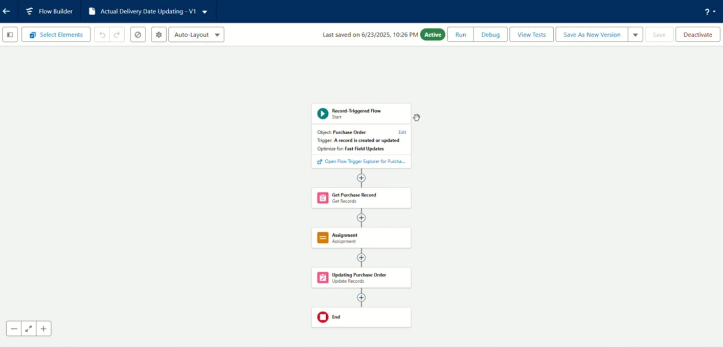
Triggers
Triggers in Salesforce are pieces of Apex code that execute before or after specific data manipulation events on Salesforce records, such as insertions, updates, deletions, and undeletions.

Slide 17
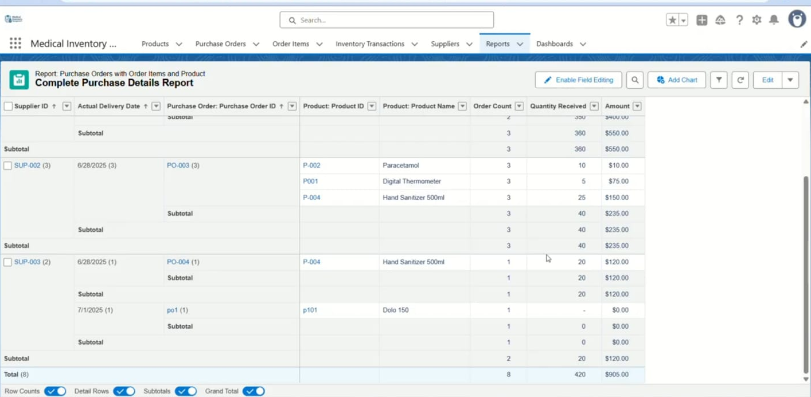
Reports
Reports in Salesforce provide a powerful way to visualize and analyze data stored in your Salesforce organization. They allow users to create, customize, and share different types of reports based on data from standard and custom objects. Reports help organizations make informed decisions by providing insights into key metrics, trends, and performance indicators

Slide 18
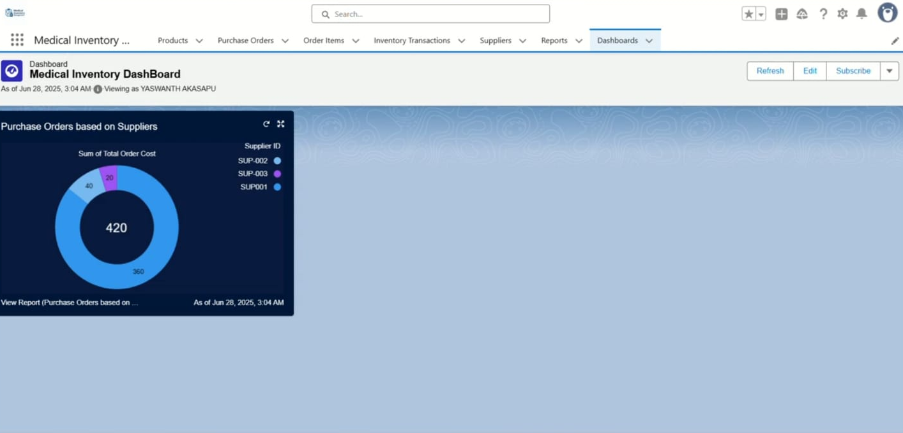
Dashboards
Dashboards in Salesforce are dynamic visual representations of key metrics and data from reports, providing a consolidated view of organizational performance and trends.
Conclusion
The proposed Smart Medical Inventory Management System will optimize resourceus
age, ensure timely availability of medicines, reduce wastage, and support better patient care. This project aligns with Naan Mudhalvan’s objective of creating industry-relevant, impactful solutions for real-world problems.

